Slide 1


The Basics of R
An Introduction to the R Programming Language for ADF&G Fishery Biologists
December 2020
Instructor: Justin Priest
https://github.com/justinpriest/R_Intro_ADFG/

Slide 2
Course Outcomes
By the end of this “class” you will be familiar with the basics of R
Hopefully, you’ll be familiar enough to read it, and can use these slides as a reference when you write
Don’t get bogged down in the details or try to memorize everything, this is a language after all.
We will run through some things together and then you can run through some of it on your own later
Notes:
Because of this, the slides are intentionally a little bit wordy. I apologize for that as it makes the aesthetics worse but I want this document to serve a little bit as a reference guide for you.

Slide 3
Course Outcomes cont.
1 – Remember: Recognize basic codes / commands. Recall resources
2 – Understand: Know the how & why of what code does
3 – Apply: Use this knowledge in new situations
Not everyone needs to be an expert, but if you’re here, I want you to move up a level and at least be able to “read” R

Slide 4
Learning Philosophy
This is a “failure positive” zone!
You can’t break anything. Be creative, think like a kid, see what happens when you type things.
Sometimes you should pay close attention to the slides, sometimes you should be practicing in RStudio; I’ll let you know
Ask questions! There are no dumb questions when you’re learning a language
One remote teaching request: if possible, keep video on that way I can see your faces
Notes:
Teaching philosophy thanks to:
http://teachtogether.tech/en/index.html
https://journals.plos.org/ploscompbiol/article?id=10.1371/journal.pcbi.1006023

Slide 5
Learning Philosophy cont.
The Rules
Be kind: all else is details
Remember, this includes being kind to YOU
We are teaching & learning this together
Teach each other
Every mistake is a lesson
Ask me or yourself why something didn’t work
Communicate when I’m going too fast
Let’s keep this a dialog
Notes:
Teaching philosophy thanks to:
http://teachtogether.tech/en/index.html
https://journals.plos.org/ploscompbiol/article?id=10.1371/journal.pcbi.1006023

Slide 6
When to Use R
While I’m a huge proponent of R, it is extremely important to realize that R is not the right tool for every job unless you are very proficient.
USE R
You need modeling or any other statistics done.
You will make a complex figure not possible in Excel.
You will be updating the figure many times in the future.
You will be working with biometricians.
DON’T USE R
You are making a figure that will probably never be updated.
You are doing quick analysis.
Time is of the essence.
Notes:
In general, there will be a huge upfront cost to R. If this is something repeatedly worked on by multiple people over a long time, that makes the upfront cost worth it.
Do not be afraid or embarrassed about googling things. I have been writing R for 4 years and google extremely simple details all the time.

Slide 7
Sections
Introduction
1 – About R
2 – The Basics of Programming
3 – Working With Your Data
4 – Basic Data Manipulation
5 – Let’s Make Charts
6 – Basic Analysis
7 – Tidyverse
8 – Other Thoughts
Explore
Wrangle
Visualize
Model
Simplify
Notes:
In the first section we’ll go over what R is, the basic overview of the “grammar” used, and some simple commands. For this first section, it will mostly be powerpoint based so follow along with the slideshow.
In sections 2 through 6 we’ll cover more about how to understand what R is and how to get it to do what you want. These are broken into individual script files for each section so that you may follow along. We’ll build a little bit more on the foundations previously learned with each section.
Section 7 covers its own group of R packages that are little bit of an offshoot but are easier to understand and use.
Finally, in Section 8 I’ll just add some parting thoughts about how best to use R.

Slide 8
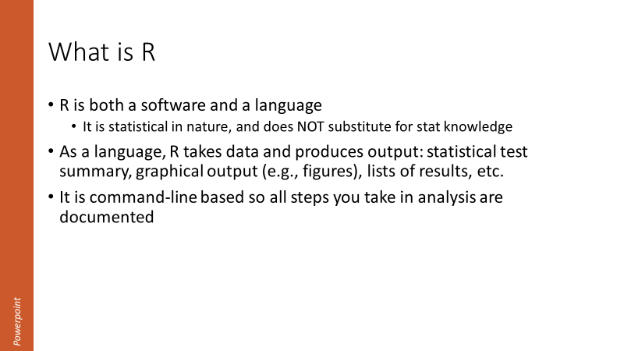
Guide
We’ll be working in programs today: follow along in PowerPoint, follow along / self-directed RStudio, and Quizzes in a browser
Follow along in PowerPoint
Follow along in RStudio
Quiz!
Introduction to topic. Take notes or just follow closely
Apply knowledge, evaluate commands. (Refer back to PowerPoint if needed)
Self-directed quiz. Evaluate in RStudio or in head. Ask yourself why you were correct.
Notes:
The only point of quizzes is for me to understand which parts to focus more on
Most quiz questions are open-ended and not scoreable. I’ll hopefully understand where I didn’t explain things as well.

Slide 9
Guide cont.
There are several types of scripts that we’ll work through in RStudio
In the “code” folder, you’ll find:
Files that start with numbers (e.g., 1_First_script.R) will be walked through together.
Folders/files that start with “Tutorial” which are a review of the topics just learned with small & quick coding exercises
Files that start with “motivatingexample” are more advanced scripts intended to show you the usefulness of R. Don’t get bogged down in the details!

Slide 10
1 – About R

Slide 11
What is R
R is both a software and a language
It is statistical in nature, and does NOT substitute for stat knowledge
As a language, R takes data and produces output: statistical test summary, graphical output (e.g., figures), lists of results, etc.
It is command-line based so all steps you take in analysis are documented

Slide 12
Why Use R?
R is relatively simple to learn
Allows for reproducible research
“Saves” all your data manipulations in a file
Can program loops to do same thing many times, very quickly
Allows for very high-powered statistical modeling
“If you can do the modeling in another program, you can do it in R”
Three features (open-source, modular design, active community) allow for evolving features and constant advances
Notes:
Community is very welcoming of new people, very diverse, supportive of its members

Slide 13
Jargon
Console – The bottom part of the program where you can enter code to be run and where executed code is shown
Line – In the “script” section of RStudio each command (kind of like a complete sentence) has its own line. Lines must be complete bits of code otherwise they won’t evaluate (to wrap an incomplete chunk of code to the next line, it must end in a comma or something similar
Script – A collection of lines of code saved to a file that can be run line by line, or all at once, usually the file extension is .R
If you want to save the code to use it again, you must save it in a script file

Slide 14
Jargon cont.
Function – A set of commands that evaluates your data in a specific way. You can write your own function, or they can be provided via other packages
Argument – In a function, this tells the function how to proceed
E.g., mean(data, na.rm = TRUE) uses an argument to remove NAs
Package – A group of new commands / functions to extend the usability of your analysis.
Object – When something is saved in R’s memory it is saved as a specific type of item, with certain properties
A common subset of these are “variables”

Slide 15
Jargon cont.
Dataframe: A group of rows and columns (like a spreadsheet). Each column has a specific structure type (TRUE/FALSE, integer, number, character, factor, etc).
Factor: A type of variable that is a categorical grouping (“red” vs “blue”; “Treatment1” vs “Treatment2” vs “Treatment3”).
= equals sign sets something to a variable (by convention this is a static number, character, etc, not a dataframe)
<- The “leftward arrow” sets the items to the right to be equal to the variable on the left. For example, x1 <- NewVariable (We can use the rightward arrow too but this is less common)
c() Lowercase c means concatenate which groups a bunch of things together. For example, x1 <- c(“New Variable1”, “New Variable2”)

Slide 16
Even more Jargon
[] square brackets mean selecting a subset
== To check if things are equal, you’ll need two equals signs together
!= To check if things are NOT equal, use this
(There are others that are used less commonly: & means AND, | means OR, ! means NOT, %in% means in a list)
~ in base R the tilde usually means “regressed upon”

Slide 17
Jargon / basic commands
rm() removes a variable from your workspace
str() inspects the structure of a variable
$ selects a particular column of a dataframe (e.g., dataframename$col1)
packagename::packagefunction() calls a function from that package
(in the uncommon event you need to call a function without loading the package; maybe there was the same function name in two packages).
# makes a comment, noting to R to not run anything on this line to the right
> print(“Hello!”) #This line only evaluates the Hello! part ignoring this
Other thoughts: Lines have to end with a comma, bracket, or similar. If you want your code to continue to the next line, you will need a comma at the end of a line
Notes:
You don’t need to know the packagename::packagefunction() for today but it’s worth knowing what the two semi-colons do in case you see it in the future

Slide 18
RStudio
RStudio is a popular program that runs on top of R
There are other “IDEs” to use but this is the best suited to R
It is HIGHLY recommended to just use this
I will not show or use the base program R today
Allows for more powerful features and is much more user friendly
Downsides: None until you’re a world-class expert
Notes:
R is the language (and a very minimal program); RStudio is a full featured program. Think of Notepad vs MS Word.

Slide 19
RStudio cont.
You’ll see 4 panes. By default they are:
Script editor in top left where you can write code before evaluating it,
Console in bottom left where code is evaluated and output is seen,
Environment in top right where you can see variables/dataframes (click on them to open up and view them!),
Plot/Help area in bottom right.
gif: https://www.pipinghotdata.com/posts/2020-09-07-introducing-the-rstudio-ide-and-r-markdown/

Slide 20
RStudio cont.
Workspace
Projects
Session
Notes:
RStudio also allows the usage of RProjects which makes a .rproj file in your root folder. When you want to start up RStudio again for a specific project, open your RProject file and it will re-open all of your script files that you last had open, convenient!

Slide 21
RStudio
Let’s familiarize ourselves with RStudio
You are unfortunately learning two things at once: the new-to-you program RStudio and the R language
I’ll show you how to use RStudio and we’ll review the basics of the program. You can watch my screen and/or run the lines yourselves. We’ll assess ADF&G data that you use
Ask questions in the chat or interrupt. PLEASE!
Later, revisit the script on your own. Consider modifying lines
Read the comments then run the line (“Run” or ctrl+Enter)
Go slow, it isn’t a race
Ask yourself why something works or fails

Slide 22
RStudio Summary
What we just learned
How to open a R project
4 panes in RStudio
How to run a line
Difference between script & console
Autocomplete for functions
Highlighting a word
Help
Viewing a dataframe

Slide 23
2 – The Basics of Programming
Did you know today was the day you became a programmer?

Slide 24
Errors
If you use R, you WILL get errors
You’ll get errors every other line (I do!) and that is OK!
Don’t stress about an error, just find what the issue is
Errors don’t go away, you just get faster at solving them ☺

Slide 25
Basic Programming
To set objects we use “=“ or “<-”. By convention, use equals for setting variables that don’t change (x=5) and the arrow for everything more complex
You re-write over previous values every time you evaluate
R is case sensitive
Use ctrl+Enter (CMD+Return) or run button to evaluate
> x = 5
> x
[1] 5
> x = 7
> x
[1] 7
> X
Error: object 'X' not found

Slide 26
Basic Programming cont.
> x1 <- c(10, 8, 10, 12)
> mean(x1)
> x2 <- c(1, 2
log(), sqrt(), sum()
c() is short for concatenate, or combining things together
Lines can’t continue if left unfinished
Your turn: explore what happens when you take log of something

Slide 27
Basic Programming cont.
Enter the following code:
x3 <- c(2,4,6,8,10)
x3[5]
This returns the 5th element (10)
myfirstdf <- data.frame(sex = c("Male", "Male", "Female"),
length = c(110, 112, 90),
weight = c(3, 3.4, 2.4),
age = c(2, 2, 1))
myfirstdf
Look at this dataframe! You’ve got some data!

Slide 28
Basic Programming cont.
Single quotes ‘x’ are usually interchangeable with double quotes “x”
Often you put things in quotes when they’re a variable inside a function or conversely when you’re telling R about a character string

Slide 29
NAs
If you import your own data, you’ll inevitably run into NA issues.
An NA is just a known “blank”
R will often throw errors for NAs
You can usually remove NAs in a function (usually good idea) or filter them out ahead of time
> mean(c(3,4,5,6,NA))
[1] NA
> mean(c(3,4,5,6,NA), na.rm = TRUE)
[1] 4.5
Remember:
“A blank is not a zero!”

Slide 30
Operators
X
Y
X | Y
& means “and”
| means “or”
! means “not”
xor() is a rare command
X Y
X Y
X Y
X & !Y
!X & Y
X & Y
X Y
X Y
X Y
xor(x, y)
X Y
Notes:
xor() is covered here for completeness but to be honest I’ve never used it

Slide 31
A Word About Types
All objects have attributes and these attributes MUST be compatible within themselves
For example, if you have a list of variables
> c(1,2,3,4,5)
Then these will be numeric. But if you have
> c(1,2,3,4, “five”)
Then these will ALL be characters
Use str(), typeof() to check the structure and type of objects

Slide 32
Object Types
Vector
Matrix
Factor
List
Data Frame
and others!
Dataframes are what you’ll use 90% of the time
> as.vector(c(3,4,5,6))
[1] 3 4 5 6

Slide 33
Variables
What is a variable?
Variable Naming:
NEVER name something the same as a function (e.g., “mean”)
Can’t start with a number
Can’t contain a space
Make it unique and memorable
Upper vs lowercase
Good
juneaurain_2005-2019
blackcod_surveycount
tanner_chela
Bad
x
dataframe1
mean
weight
Notes:
Why would we want to set something as a variable?

Slide 34
Errors Revisited
Some common errors:
Misspelling variable/function
Not ending a line in parenthesis, comma, etc.
Unpaired parentheses/quotes
Capitalizing vs no caps
Not loading package before calling function
Wrong data type is used
RStudio will help minimize these!
Experience, going slow & thorough minimizes these!

Slide 35
Errors Revisted cont.
Error Message | Possible Problem
unexpected symbol in ____ | You made a syntax (coding grammar) error (extra comma, parenthesis, etc.)
could not find function | You forgot to load a package or misspelled the function name.
cannot open file .* : No such file or directory | You tried a path that doesn't exist.
there is no package called ___ | You forgot to install a package or misspelled the package name
object .* not found | The object you are looking for might not exist.
non-numeric argument to ___ | You tried to use a character vector where a numeric is needed.
attempt to apply non-function | You tried to use an object which is not a function as a function.
object of type 'closure' is not subsettable | You called `$` on a function.
More common
Less common
Based on https://github.com/colinfay/argh
Notes:
Don’t memorize this list! Instead use it as a reference to come back to.
These are somewhat organized from the error messages that you’ll see today to those that are a little more obscure

Slide 36
Stop! And Restarting
Practice closing out of RStudio and then reopening. You can click save workspace or not. See what happens when you do both!
Practice closing out of a long loop (stop button) and open-ended code (esc key in console)

Slide 37
Quiz 2-1
Which one of the following will run?
c(1,2,3,4, “five”)
c(1, 2, 3, 4, 5)
c(1, 2, 3, five)
C(1,2,3,4,5)
Now test your answers in R
Which two make a numerical sequence?
seq(1:10)
Seq(1:10)
seq(from=5, to=25, by=2)
Seq(start=5, end=25, by=2)
QUIZ!

Slide 38

Quiz 2-1 ANSWERS
Which one of the following will run?
c(1,2,3,4, “five”)
c(1, 2, 3, 4, 5)
c(1, 2, 3, five)
C(1,2,3,4,5)
Which two make a numerical sequence?
seq(1:10)
Seq(1:10)
seq(from=5, to=25, by=2)
Seq(start=5, end=25, by=2)
QUIZ!
Why didn’t these run?
Case sensitivity, combining types, and calling an object that doesn’t exist
Why didn’t these run?
Case sensitivity, used wrong code inputs

Slide 39
3 – Working With Your Data
It’s cooler than the underside of your pillow

Slide 40
But First! Directories
Before getting your data in, you should know where R thinks you are
By using modern tools in R (especially RProjects) we avoid most of the previous headaches with directories; regardless, it’s important to be aware of it.
Type getwd() to see what your working directory is. What happens if you write:
> read.csv(“input.csv”)
It can’t find the file. Change this to
> read.csv(“data/input.csv”)

Slide 41
Directory Structure
In ADF&G, we try to use a standardized folder structure so that everyone knows where everything is.
Under your main project folder, use one .Rproj for that group of analyses. Use folders of “data”, “code” (or “analysis”), “output”, etc.

Slide 42
Packages
A package is just a collection of new functions (commands) for us to use. If you’ve never used the package before install it to R by running install.packages(“packagename”).
After this, you load it into R by running library(“packagename”).
You’ll need to load your libraries every time you restart R, so add the libraries you’ll need for that specific script at the top.
Run Once! (until you update R)
> install.packages(“dplyr”)
> library(dplyr)
Run every time you open R

Slide 43
Packages cont.
Common packages are the tidyverse collection (more on this later!),
lubridate for dealing with dates (get it?!),
scales for dealing with ease of plotting axis scales,
extrafont for fonts other than default,
here for relative filenames (if you share / rename file directories),
cowplot or patchwork for putting multiple plots together,
mgcv or nlme for more advanced modeling,
vegan for multivariate statistics,
1000s of others.

Slide 44
But Wait! There’s More!

Slide 45
Data
Before getting your data in, you will need to make sure that it is “machine readable”
Don’t use summarized data (if possible)
To the extent possible, do cleanup in R so that if you re-download from OceanAK you don’t have to spend time changing things
Starting out, it’s completely fine to clean things up in Excel first
Don’t use “tabled” data, e.g., Year by Stream
Use “long” format with many rows where each row is a year and a stream
This is tidy data

Slide 46
Tidy vs non-tidy data
Which of these datasets are tidy data?
Trick question! Neither are

Slide 47
Tidy vs non-tidy data
To see why, if there were a comment, which does it refer to?
Comments
No fish 7/24-8/25
Stopped early
Not sampling
Crew quit
Comments
Skipped 2
Not sampling
Used pink mesh
We quit
This is pretty close to tidy though!
Notes:
Why isn’t this tidy? If the last column were for “comments”, which observation would the comment refer to?

Slide 48
Data cont.
What is tidy data? From the tidyr overview:
“Tidy data is data where:
Every column is variable.
Every row is an observation.
Every cell is a single value.
Tidy data describes a standard way of storing data that is used wherever possible throughout the tidyverse. If you ensure that your data is tidy, you’ll spend less time fighting with the tools and more time working on your analysis.”
Using R and the tidyverse will make you better with your data. While Excel is great for many things, especially quickness, it allows for bad habits. For example, it will let you combine different types of data into the same column (a column for “Length” can include 100, TRUE, “No sample here”; this is a massive data issue).

Slide 49
FINALLY! Getting data into R!
Import things as a .csv if you can
This prevents issues by using a static file (i.e., no formulas)
You can still import files in .XLS or .XLSX but it’s good practice to use “flat” files
Use “read.csv()” base or “read_csv()”
For now because we haven’t loaded (or learned about) the “tidyverse” we can only use read.csv(). In the future, using read_csv() is probably a better idea

Slide 50
SHOW ME THE DATA
OK so you have your data in. How can we look at it?
Type the name in console (shows first few rows/columns)
Type View(dataframe_name), or click on the dataframe name in the top right pane (same as View).
Once you have it open to view, you can now filter, sort, scroll, etc.
Not all data are created equal. Sometimes you might have issues and need to see what kind of data you have. Type str(dataframe_name) to see the structure; less commonly you might need to know the class()

Slide 51
Data Import
Analysis Checklist
Data is:
QA/QC’d
Flat file (.csv, etc.)
Not summarized
One row/observation
Make a new directory & RProject

Slide 52
Let’s play with data
Motivating example 1

Slide 53
4 – Basic Data Manipulation

Slide 54
What is data manipulation
Now that you’ve got your data into R, you’ll usually have to modify it in some way. This includes:
Excluding certain years or species
Adding a new calculated column (CPUE)
Pooling groups together
Why do this in R?
You’ll always have a record of what you did to your data
Your script can repeat process (e.g., if you re-download data out of OceanAK and need to rename data, add a calculated column, etc.)
The best package for this is “dplyr” (& other tidyverse packages)

Slide 55
Filtering
You’ll often need to exclude or subset a group of data
Use filter() to keep certain rows
You might want to exclude NAs
This is a little trickier because something can’t be equal to an unknown. Use is.na()
> filter(dataframename, Year == 2018, Species != “Pink salmon”)
> filter(dataframename, !is.na(Length))
> filter(dataframename, Year == 2018 | Year == 2019)
> filter(dataframename, Year == 2018 & Year == 2019)
This would return no rows. Why?
Year can’t be 2018 AND 2019
Notes:
Command filter() is from the dplyr library so you’ll need to load that first

Slide 56
Rename Columns
Columns often need to be renamed to something more manageable or descriptive, use rename()
If columns come from OceanAK with spaces in them, R imports them to have backticks, e.g., `Column 1 Name`. Rename these to remove spaces
> rename(dataframename, “newcolumnname1” = “oldcolumnname1”, “newcolumnname2” = “oldcolumnname2”)
> rename(dataframename, “newcolumnname1” = `old column`)
Notes:
Command rename() is from the dplyr library so you’ll need to load that first

Slide 57
Add New Column
mutate() provides a way to calculate a new column
You could add, divide, etc columns by each other
Though it’s more complex, you could also use an “if” statement to make a conditional column
> mutate(dataframename, newcolumn = column1 + column2)
> mutate(dataframename, newcolumn = column1 / column2)
> mutate(dataframename, newcolumn = “Good data”)
> mutate(dataframename, newcolumn = ifelse(column1 > 1, “what to write if true", “otherwise write this"))
Notes:
From package dplyr

Slide 58
Keep Only Certain Columns
> select(dataframename, columnname1, columnname2, columnname3)
> dplyr::select(dataframename, columnname1, columnname2, columnname3)
> dplyr::select(dataframename,
-columnname1)
> dplyr::select(dataframename, columnname1:columnname4)
Use select() to keep or drop columns
List all columns to keep or add a negative to drop specific columns
Note: There can occasionally be a conflict between dplyr’s select and another package. To ensure that you are using the right select, use dplyr::select(). This is a very rare issue however.
Notes:
In all the thousands of lines of code I’ve written, I only had the select conflict once.

Slide 59
The “pipe”
dplyr also brings use the functionality of a “pipe”, written as %>%
The pipe operator allows us to string together several functions and pass each of them to the next one
> dataframename <- filter(dataframename, Year == 2018)
> dataframename <- mutate(dataframename, surveymonth = month(surveydate))
> dataframename <- select(dataframename, Year, surveymonth, totalcount)
> dataframename <- dataframename %>% filter(Year == 2018) %>%
mutate(surveymonth = month(surveydate)) %>%
select(Year, surveymonth, totalcount)

Slide 60

%>% advantages
The pipe passes the object from the left to the right. Most often this passes a dataframe as an argument from the left to the right side.
This seems a little confusing at first but is convenient
Stringing together many lines of code at once is:
more readable,
doesn’t repeat the same variables over and over,
helps prevent “out of order” code problems,
reduces excessive nesting of functions within functions

Slide 61
Review & Day 1 Break

Slide 62
Review – About R
RStudio 4 panes: Script editor, console, environment, plot/help
Use <- or = to set a variable
Code must end on comma or similar
A “function” is (usually) made up of argument(s)
Variables (dataframe) are set to access later
str(), $, [], c()

Slide 63
Review – Basics
Errors
NAs
mean(), sum(), log()
Make sure to use quotes when you describe a character
Use descriptive variable names
& means “AND”, | means “OR”
A dataframe is group of columns and rows

Slide 64
Review – Working with your data
Directories – Make sure that you are in the correct directory
An RProject makes this very simple
Packages – Add more functions for us to use
Load them for use by using library()
Tidy data – One row per observation, not summarized
Check that structure of data matches what it should be
str(), especially checking for character vs factor or numerical vs character

Slide 65
Review – Data manipulation
The basic commands to modify your data are:
select() Keep or remove columns
filter() Keep rows that meet your conditions
rename() Change column names
mutate() Make new columns
The pipe, %>%, makes your code cleaner and shorter

Slide 66
Review – Tomorrow
If today was difficult, that’s expected! Pat yourself on the back, we’ve covered a LOT of material.
Remember our goals. By the end of tomorrow you will be able to:
Import your OWN data into R
Perform basic analyses
Make publication worthy figures
If you have questions or are confused about anything, PLEASE email me this afternoon

Slide 67
5 – Let’s Make Charts!
Who doesn’t love a good chart?!

Slide 68
Chart Types
First, decide how to present your data
Are you looking to show:
Trend over time
Composition
Compare / contrast
Distribution
Relationship

Slide 69
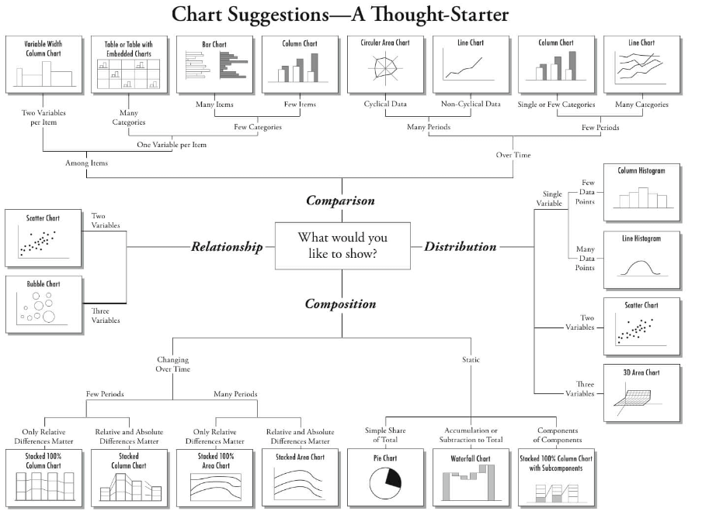
Chart Types

Slide 70
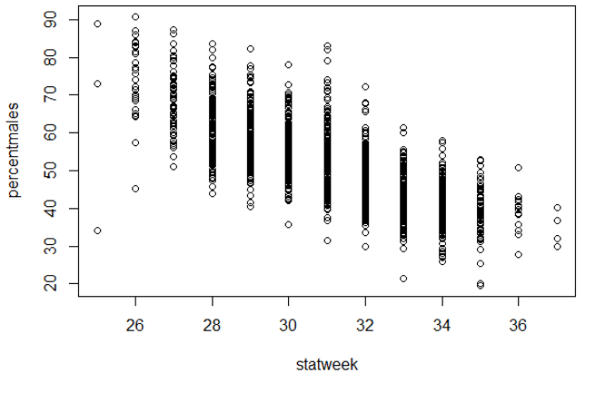
Chart Basics
Use base function plot()
Syntax is plot(yaxiscolumn ~ xaxiscolumn, data = dataname)
Using plot() is very quick and easy!

Slide 71
ggplot2 – A Better Way
We’re getting ahead of ourselves: ggplot2 is part of the “tidyverse” group of packages. We’ll learn more about them later
Why use ggplot2 over base plot?
Faster to hit ground running
If you make anything beyond basics, it’s easier

Slide 72
ggplot2
Use a “+” to connect between lines
The aes() command is the “aesthetics”. Set which columns are equal to x, y, color, fill, and group.
Control aspects of the axes (and other parts) with “scale_”, e.g., scale_y_continuous, scale_x_discrete
Add data using “geom_”, e.g., geom_point(), geom_line(), etc
Set visual elements using theme()
Establish the plot
> ggplot(data = mydataframe, aes(x = xcolumn, y = ycolumn, group = Year)) +
scale_x_continuous(breaks = c(1990, 2000, 2010, 2020)) +
geom_line()
Control x axis (set axis breaks)
Create lines

Slide 73
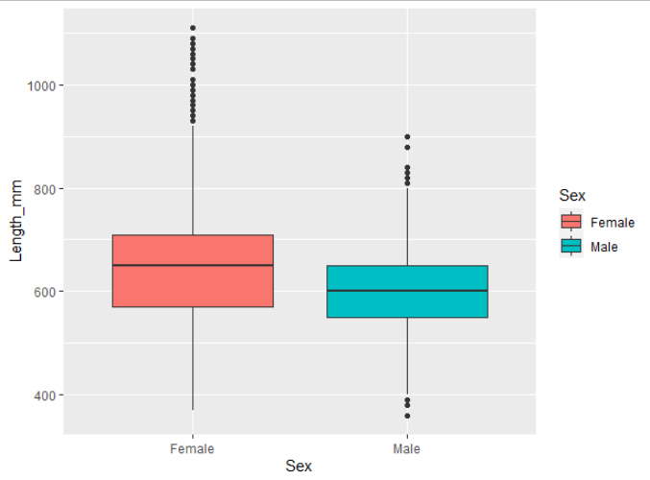
Anatomy of a ggplot
Establish which dataframe to look at
ggplot(data = sablefish,
aes(x=Sex, y = Length_mm,
fill = Sex)) +
geom_boxplot()
“Sex” should be along x-axis, with length on y.
Fill the objects based on the Sex column
Create a boxplot!

Slide 74
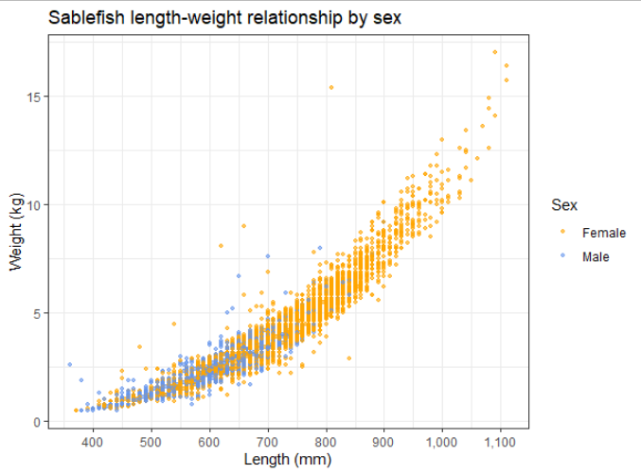
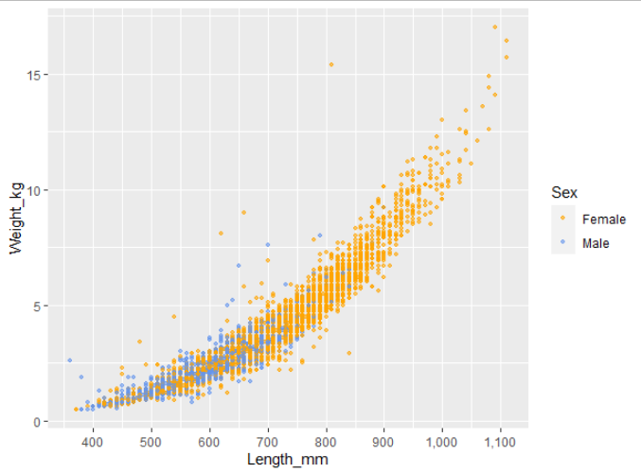
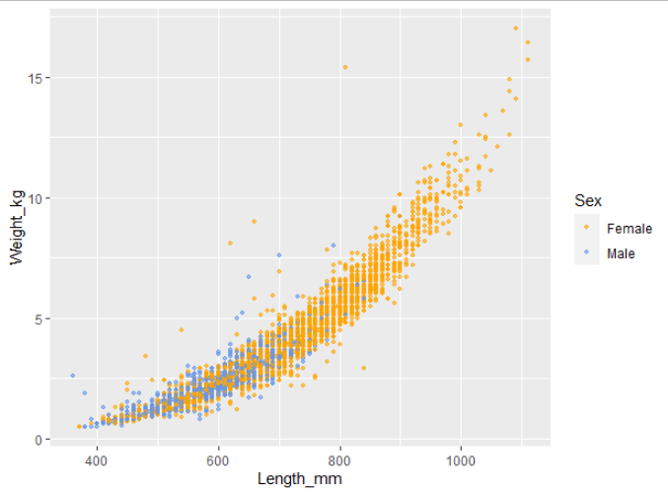
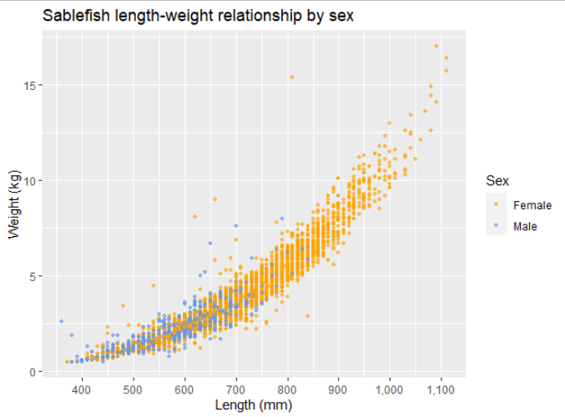
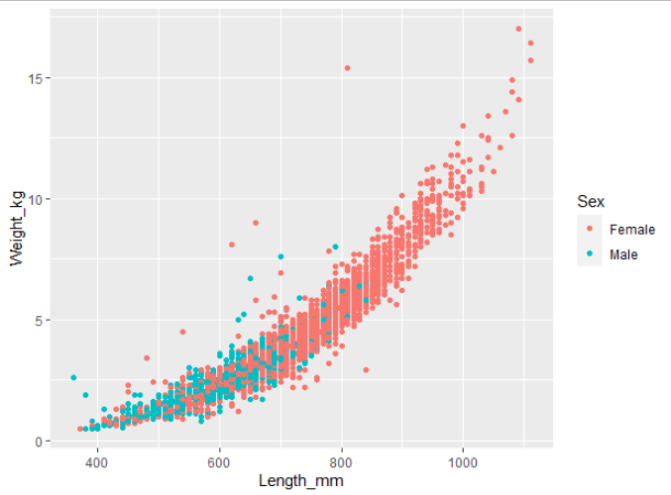

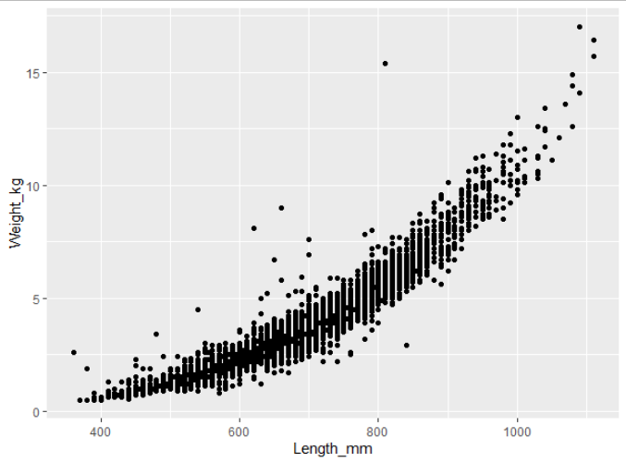
Anatomy of a ggplot
> ggplot(data = sablefish, aes(x = Length_mm, y = Weight_kg)) +
geom_point()
> ggplot(data = sablefish,
aes(x = Length_mm,
y = Weight_kg,
color = Sex)) +
geom_point(size = 0.9, alpha = 0.6) +
scale_color_manual(values =
c("orange", "cornflowerblue")) +
scale_x_continuous(breaks = c(400,
500, 600, 700, 800, 900, 1000,
1100, 1200), labels = scales::comma) +
labs(x = "Length (mm)", y = "Weight(kg)",
title = "Sablefish length-weight
relationship by sex")
> ggplot(data = sablefish,
aes(x = Length_mm,
y = Weight_kg,
color = Sex)) +
geom_point(size = 0.9, alpha = 0.6) +
scale_color_manual(values =
c("orange", "cornflowerblue")) +
scale_x_continuous(breaks = c(400,
500, 600, 700, 800, 900, 1000,
1100, 1200), labels = scales::comma) +
labs(x = "Length (mm)", y = "Weight(kg)",
title = "Sablefish length-weight
relationship by sex") +
theme_bw()
> ggplot(data = sablefish,
aes(x = Length_mm,
y = Weight_kg,
color = Sex)) +
geom_point(size = 0.9, alpha = 0.6) +
scale_color_manual(values =
c("orange", "cornflowerblue")) +
scale_x_continuous(breaks = c(400,
500, 600, 700, 800, 900, 1000,
1100, 1200), labels = scales::comma)
> ggplot(data = sablefish,
aes(x = Length_mm,
y = Weight_kg,
color = Sex)) +
geom_point(size = 0.9, alpha = 0.6) +
scale_color_manual(values =
c("orange", "cornflowerblue"))
> ggplot(data = sablefish,
aes(x = Length_mm,
y = Weight_kg,
color = Sex)) +
geom_point()
> ggplot(data = sablefish,
aes(x = Length_mm,
y = Weight_kg,
color = Sex)) +
geom_point(size = 0.9, alpha = 0.6)
Notes:
Predict what next plot will be!

Slide 75
Let’s practice
In RStudio, we’ll run through the script
Towards the end, let’s make it a little bit free-form. If you have a question about how to modify the plot, challenge me.
If you need another explanation later, Dr. Lendway’s videos are great!
Intro to ggplot() – 8 min
Common ggplot mistakes – 3 min
ggplot demo – 32 min
These videos support material on her learning website

Slide 76
6 – Basic Analysis
Because using 30-year-old Excel macros is so yesterday

Slide 77
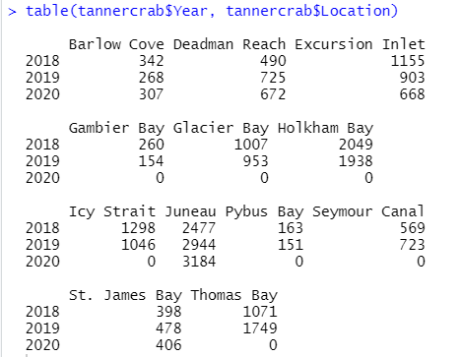
table() and summary()
These two functions quickly summarize your data
table() makes a 1x1 or 1x2 summary table of all your counts by variable
table(variable1, variable2)
summary() is a quartile distribution of your continuous data

Slide 78
group_by()
group_by() %>% summarize()
Together, these almost perform like a pivot table
group_by() can be used to produce grouped calculations in mutate()
Very fast and useful way to view data summaries
> dataframename %>%
group_by(Year) %>%
summarize(newname =
mean(variable1))
Output:
For each year, what is the mean of variable1?
(New column is named “newname” here)

Slide 79
ANOVA
It is very quick and easy to produce an ANOVA in R
This will let you test whether categorical variables have different continuous distributions (e.g., is mean length significantly different between species? Different mean weights between years?)
This isn’t a stats course but remember that there are some items to be aware of for an ANOVA (type I, II, & III)
Use aov() and NOT anova()
The Anova() function from package “car” allows specifying type!
More info here

Slide 80
Linear Modeling
Modeling a linear trend in R is EASY!
lm(response ~ independentvar, data =df)
Save this output or wrap in summary()
lm(response ~ var1 + var2, data =df)
R notation:
lm(y ~ var1)
=
Formula notation:
y = β₀ + β₁var1

Slide 81
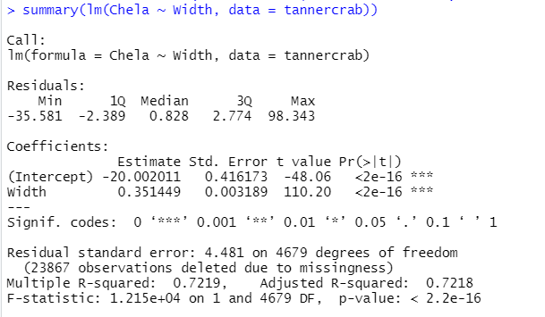
Reading lm() output
Formula
Residual diagnostics
Estimate = β₀ , β₁
Std. Error & t value
Pr(>|t|) = p-value
R²

Slide 82
Binomial
glm() binomial

Slide 83
7 - Tidyverse
It’s like R, but different. And better. Definitely better.

Slide 84
What is the Tidyverse
The Tidyverse is a collection of packages that extend the usefulness of R, use slightly different language syntax, and play well together
Some of the most common Tidyverse packages are:
dplyr – data manipulation (mutate, select, filter, summarise)
ggplot2 – produce beautiful charts
tidyr – change data layout to one observation per row, and inverse
tibble – use “advanced” data frames
readr – fast and friendly way to read in data
lubridate – work with dates
And several others!
Notes:
We previously used some of these earlier: dplyr is amazing for data manipulation and ggplot2 is amazing for plotting

Slide 85
Why Should You Use the Tidyverse?
It’s often simpler to read: filter(Year == 2010)
Forces cleaner data which will save you time later
Makes certain data types workable (e.g., dates)
More powerful features
Constantly updated (future of R?)
Downside
Syntax is different and you’ll know two different ways to do same thing

Slide 86

dplyr
Already learned about the “pipe” operator %>%
Add a new column using mutate(), choose specific rows based on column values using filter(), change whether a column is included using select(), change column names using rename()
**warning** you may find code online that uses the previous version of this package called “plyr”. If you find a function that uses plyr, I highly recommend not using it if you use “dplyr”. The two packages can (rarely) have major issues with each other.
Notes:
We’ve covered most of these previously because they’re so useful!

Slide 87
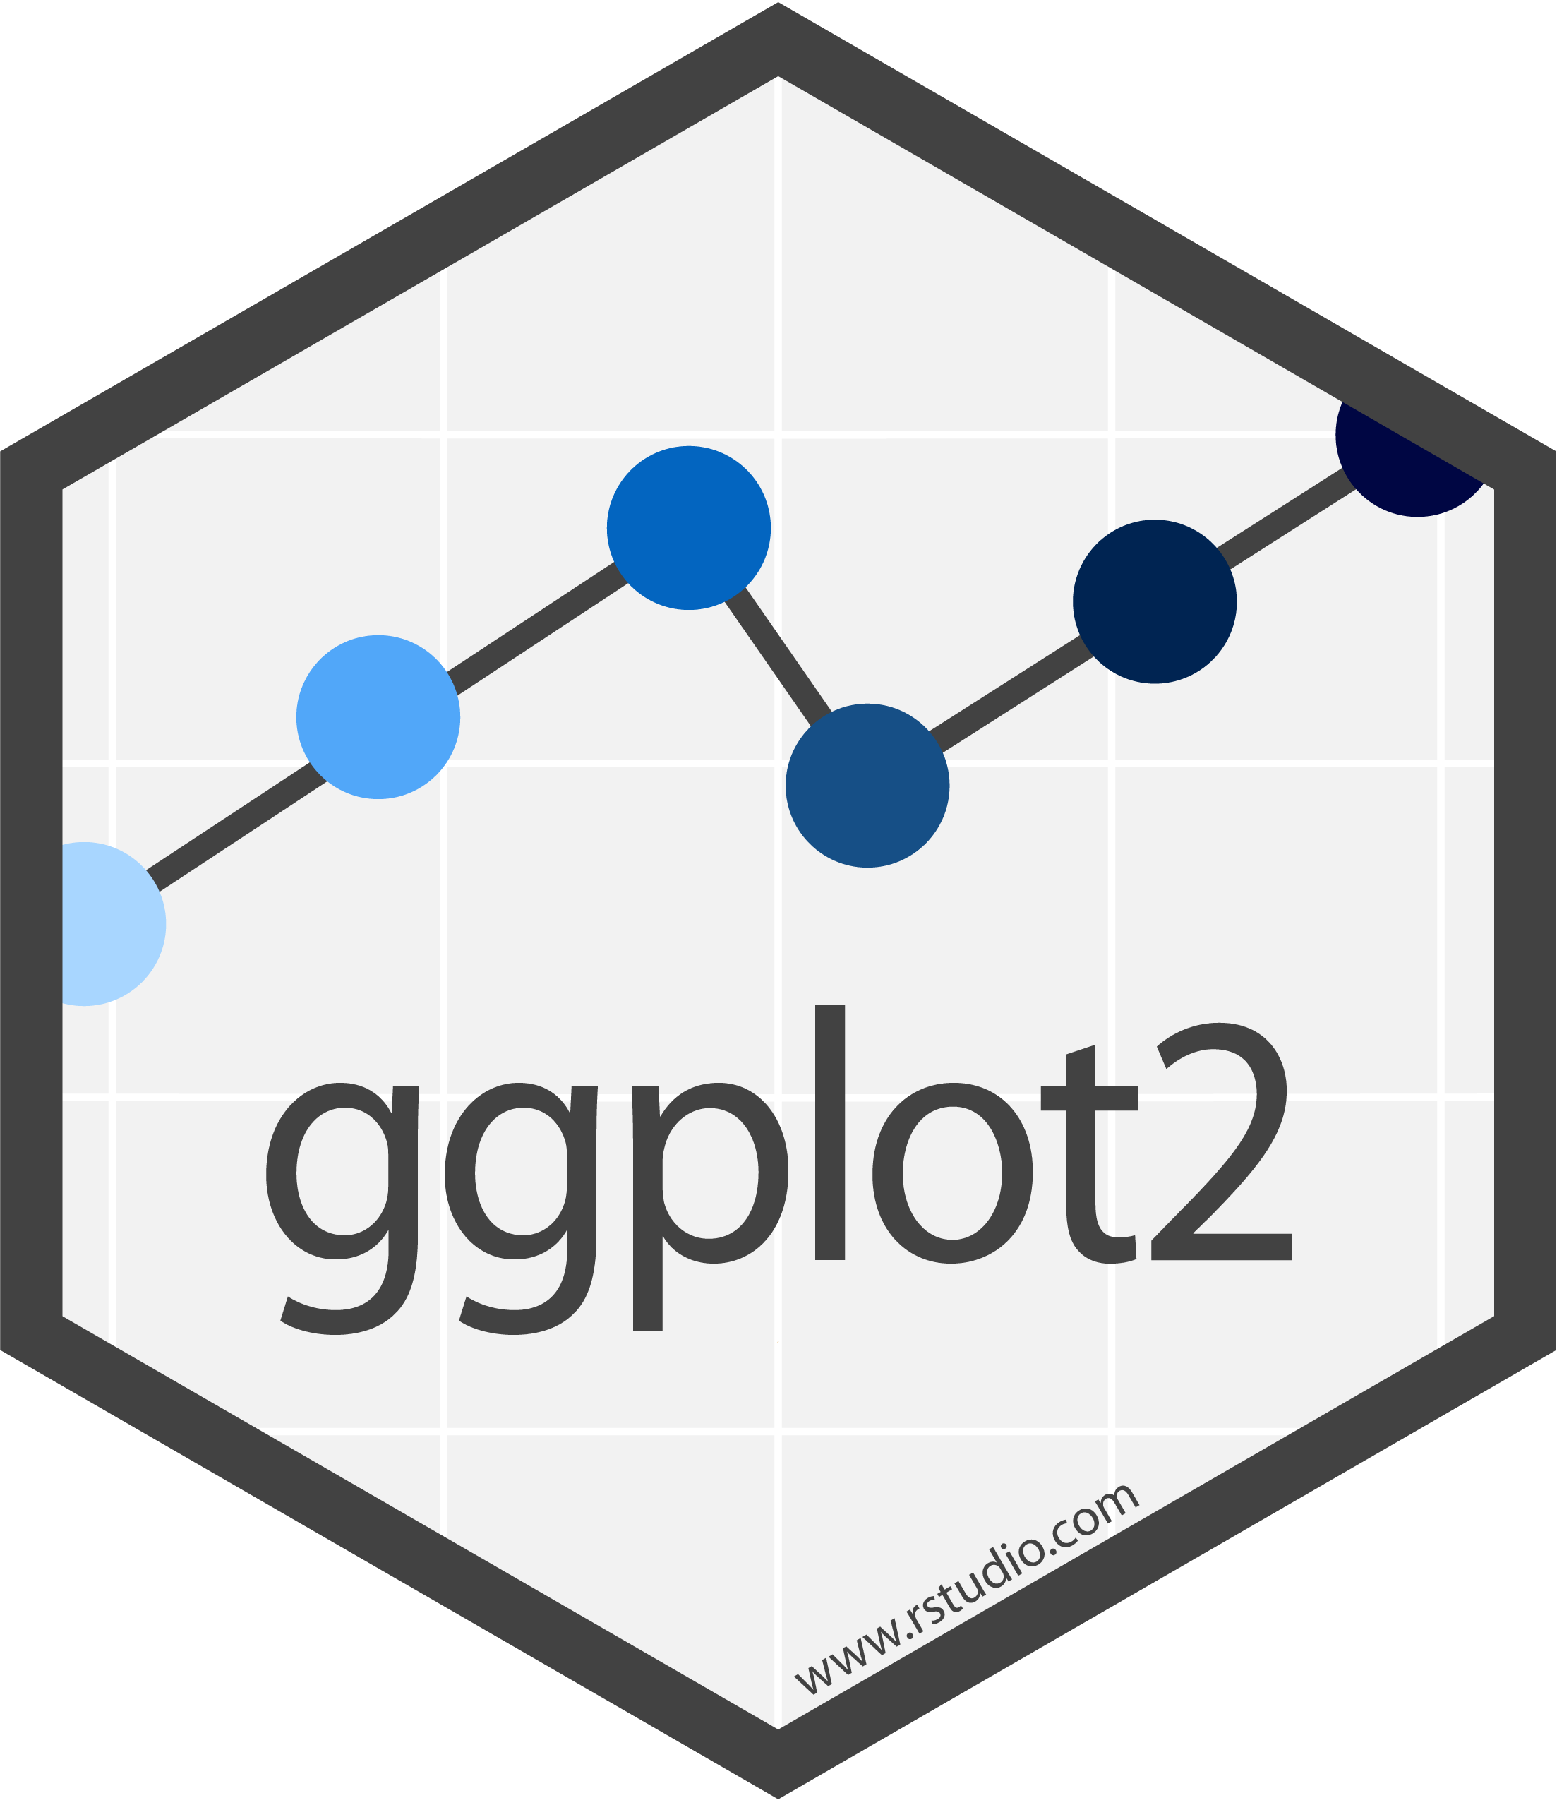
ggplot2
The most popular way to plot in R
Uses a “grammar of graphics” which takes a bit to learn
The basic structure is defining the source dataframe, the aesthetics (variables for x axis (& y axis), variables for color/shape, etc), and then a call to what type of plot you’re making (points, lines, histogram, etc)
Strings together commands using “+” between the lines
Notes:
Also covered previously

Slide 88

lubridate
Dates are probably the most difficult thing to deal with when starting out in R.
lubridate provides a better interface; can easily convert between date formats, subtract time periods, calc day of year, etc.
For “11/12/2020”, what is that month? Are you sure?
Use following code as a template when in doubt:
mutate(newdate = ymd(as.POSIXct(olddate, format = "%m/%d/%Y", tz = "US/Alaska"))

Slide 89
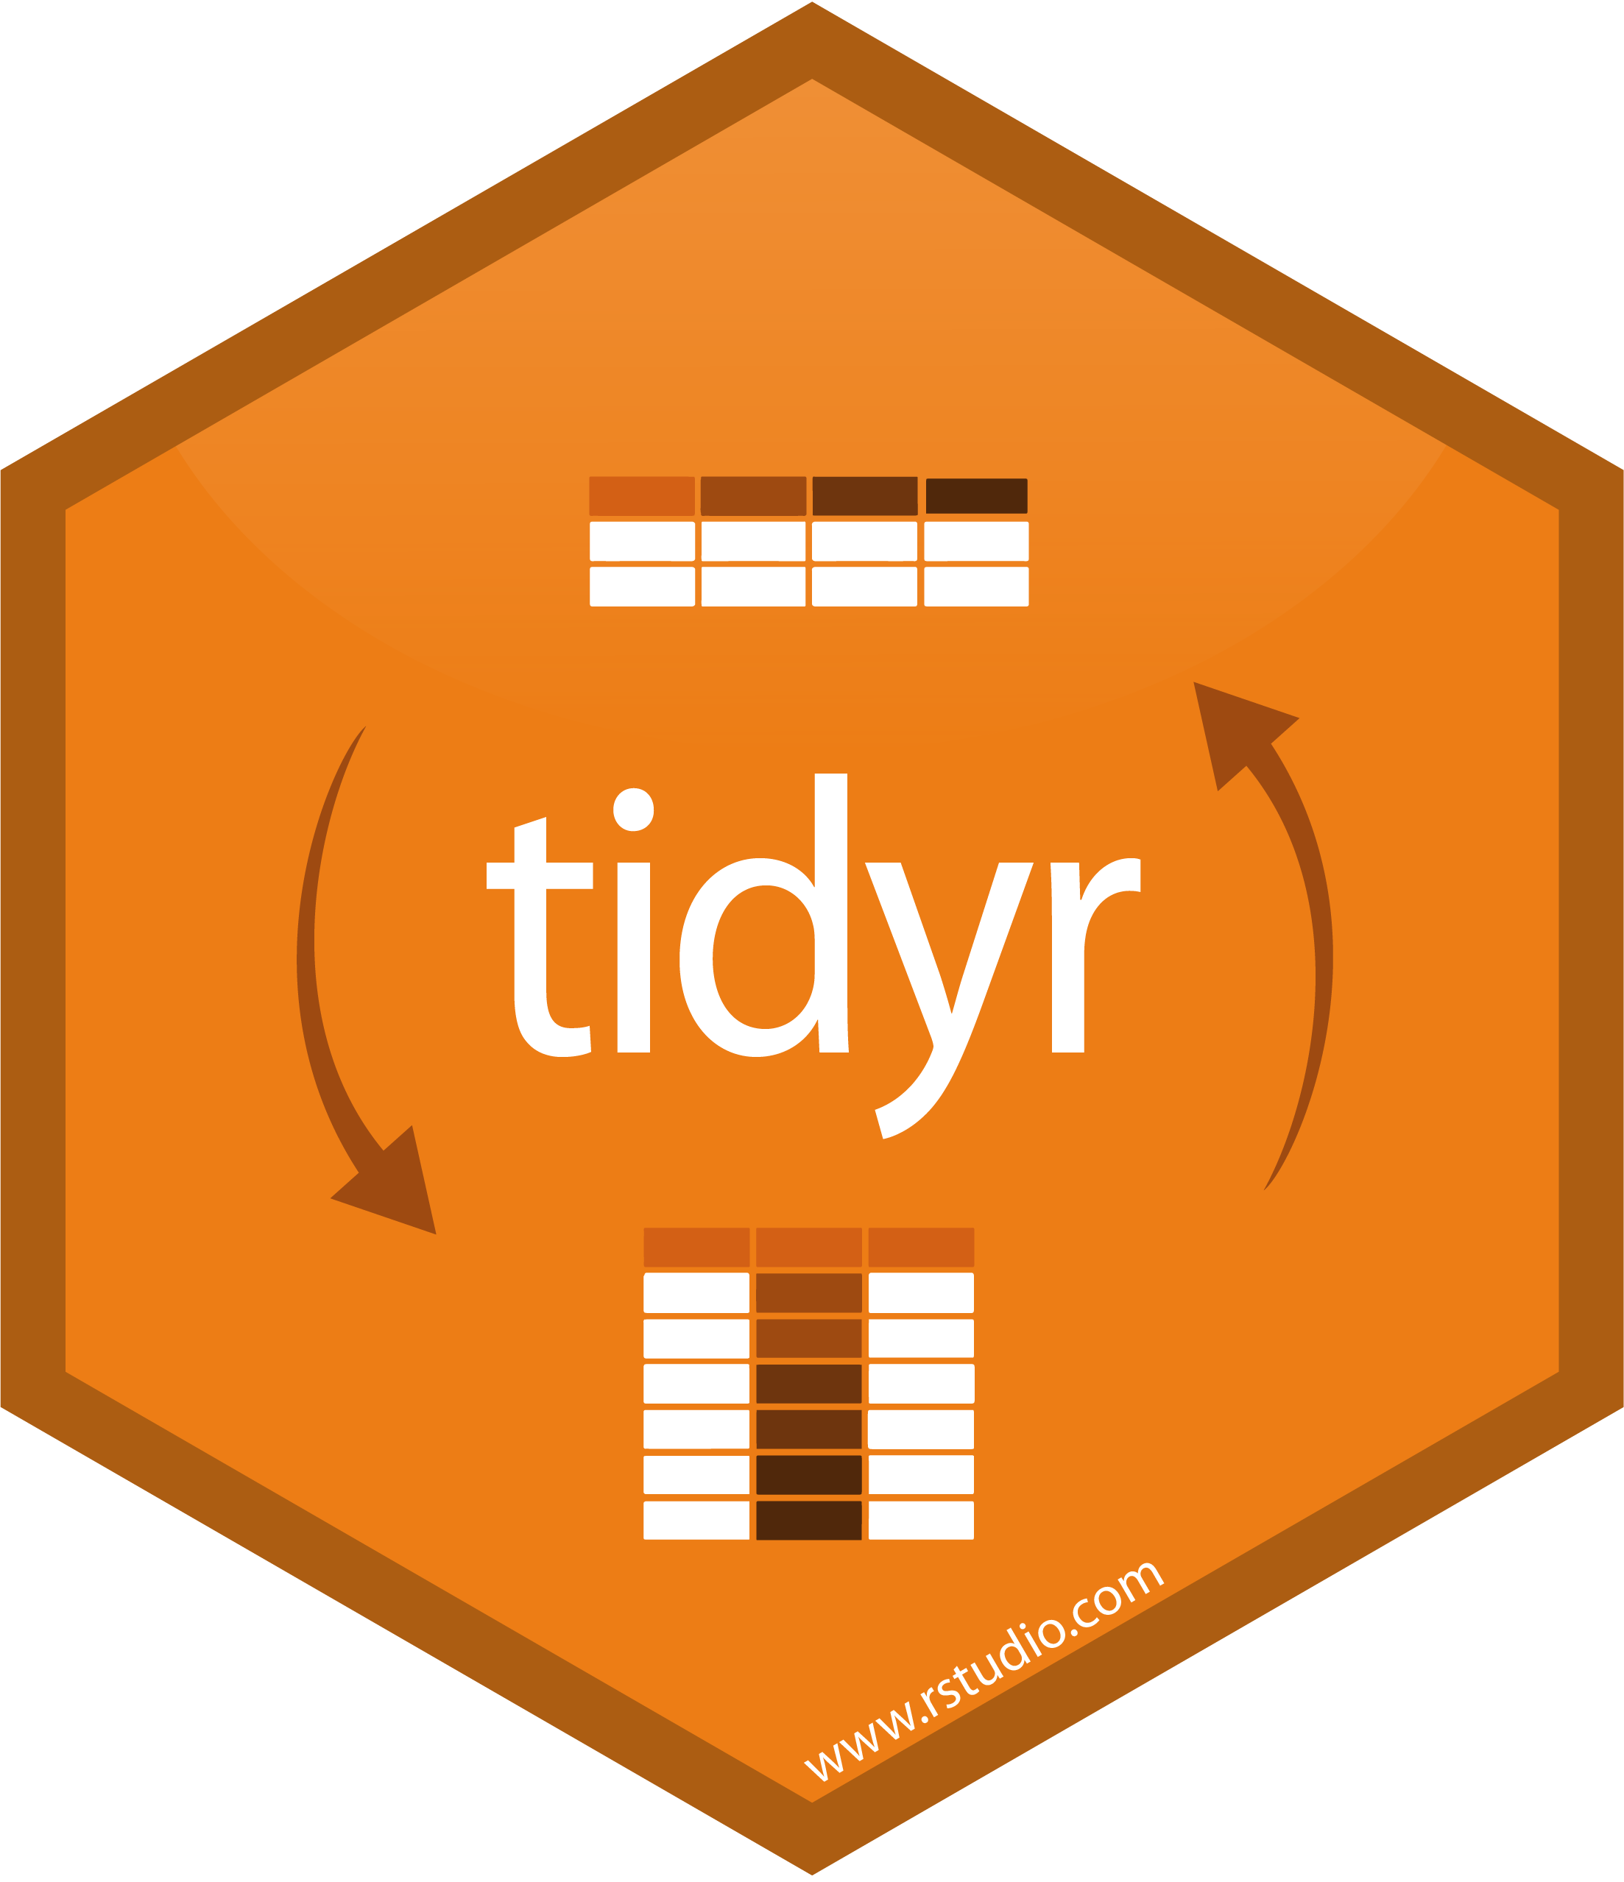
tidyr
tidyr is a package whose main functions help to turn “wide” data into “long” data and vice-versa
pivot_wider() and pivot_longer()
When possible, keep data in long format

Slide 90
Motivating Examples

Slide 91
Project
Use any dataset provided to create a visualization

Slide 92
Project Goal
Over the next hour, create a script that does the following:
Imports one of the provided datasets (your choice)
Loads needed libraries
Filters to a specific subset of data
Using ggplot, visualize some aspect of the data
Email me your plot!
Remember! It’s OK to Google how to do something. I do it for EVERY script

Slide 93
Examples
Some example projects that you could do are:
Tanner crab chela width vs crab width
Pink salmon
You are welcome (and expected) to copy code over that we’ve done together. Read error statements closely. Google your problems.
If you want to pair up and work on the same dataset, it’s fine to share code but the more you write, the more the ideas are cemented

Slide 94
Project Steps
Choose a dataset
Open in Excel to look at data
Create a new directory/project & copy over all needed files (not required but helpful if you want to use this later)
Import data into R
Perform needed data manipulation
View data, decide what to visualize
Plot in ggplot (and troubleshoot along way)
If you finish early, you can:
Message & help others
Make more plots
Do some simple analysis / summaries
If you feel like you’re not making progress that’s fine! Message me or a peer ☺

Slide 95
Chart Presentation & Concluding Thoughts
Present plots
Some miscellaneous best practices and ways to have a smoother R experience

Slide 96
Plots

Slide 97
Best Practices
R is not that great for tables but is excellent for figures
Don’t use spaces in filenames or directories if you can
Name files descriptively
Don’t overwrite previous files but rename them clearly
Use easy to understand variable names
Comment often and be VERY thorough, I can almost promise that you’ll experience frustration at yourself for not being clearer
Use several scripts that “link” together rather than one long one

Slide 98
Best Practices, cont.
Update your R version and all packages often (unless you’re about to publish and need absolutely nothing to change)
Follow people on GitHub/Twitter to read other people’s code and learn better coding practices
Read in data using .csv files (unless already in relational DB), never use file.choose(). Keep file paths relative and not static
Use “Projects” in Rstudio to keep scripts organized

Slide 99
Relative Paths
If the first line of your R script is
setwd("C:\Users\jenny\path\that\only\I\have")
I will come into your office and SET YOUR COMPUTER ON FIRE
If the first line of your R script is
rm(list = ls())
I will come into your office and SET YOUR COMPUTER ON FIRE
- Jenny Bryan

Slide 100
Relative Paths cont.
Why is this a bad idea?
If you will be the only person to ever run this code and you will absolutely never change computers, it’s fine to keep it this way.
The solution: Use relative paths and RStudio projects

Slide 101



Not Covered
So many things weren’t covered but some of the more interesting that you can look into are:
GitHub – Can sync your files to the internet which makes life MUCH simpler, especially if you are collaborating. Highly recommended
Rmarkdown – Create PDF, HTML, Word etc. files embedded with your R script outputs. Allows automatic report creations.
Shiny – This package allows for the creation of interactive apps
Spatial Analysis – Unique enough analyses to warrant its own discipline. If you can do it with ArcGIS, you can probably do it with R

Slide 102
Parting Thoughts
Like any language, becoming familiar with R requires a little practice over a long period of time. It’s easy to get discouraged right off the bat. For me, the best way to motivate myself to learn was having my own dataset to work through; for others, online tutorials were best.
Keep googling your problems; especially when starting out it is extremely unlikely that you’re the first with this issue. I still google how to do something almost every other line of code. Even the best programmers still google and read Stack Exchange.
Programming is not the same as asking the right questions: learn more statistics! It is possible that you are attempting analysis that is best accomplished differently. Or worse, doing something you shouldn’t.

Slide 103

Congrats!
This certificate is good for a free R help session, one-on-one!
Plus, you’re always welcome to ask me for help; the worst I can say is I’m busy
Notes:
I really enjoy helping people with their R questions. Please message me

Slide 104
Resources
Just Starting Out
https://cran.r-project.org/doc/manuals/R-intro.pdf
https://cran.r-project.org/doc/contrib/Paradis-rdebuts_en.pdf
https://r-bootcamp.netlify.app/
https://rstudio.cloud/learn/primers
https://ggplot-dplyr-intro.netlify.app/
long but comprehensive

Slide 105
Resources
Data Management
Data Organization in Spreadsheets
https://annebeaudreau.com/2018/02/04/data-management-tips/
Workflow
https://whattheyforgot.org/project-oriented-workflow.html
https://www.tidyverse.org/articles/2017/12/workflow-vs-script/

Slide 106
Resources
Style Guides
http://r-pkgs.had.co.nz/style.html
https://google.github.io/styleguide/Rguide.xml
Statistics
http://www.shinystats.org/
https://seeing-theory.brown.edu/regression-analysis/index.html

Slide 107
Cheatsheets
All cheatsheets
Getting started
dplyr and tidyr
Data import
lubridate
ggplot2
RStudio

Slide 108
Special Thanks
People who have taught me or whose code I have shamelessly copied and learned from:
Franz Mueter (UAF)
All UAF classmates
Ben Williams (NOAA/ADF&G)
Jordan Watson (NOAA)
Curry Cunningham (UAF/NOAA)
Jenny Bryan (UBC)
Hadley Wickham (RStudio)
Greg Wilson (RStudio)
Allison Horst (RStudio)

